Slide 1
SQL - Advanced JOINs
DBMS-1002

Slide 2
In the previous slides . . .
We covered:
A review of Tables relationships:
Keys and ERD basics
INNER JOIN ON Syntax:
Table prefixes (qualifying) and Aliases
Self-Joins
Joining multiple tables

Slide 3
In These Slides . . .
We will be covering:
The OUTER JOINs:
LEFT, RIGHT, FULL
Alternative JOIN Syntax:
WHERE JOIN,
NATURAL,
USING,
CROSS JOIN

Slide 4
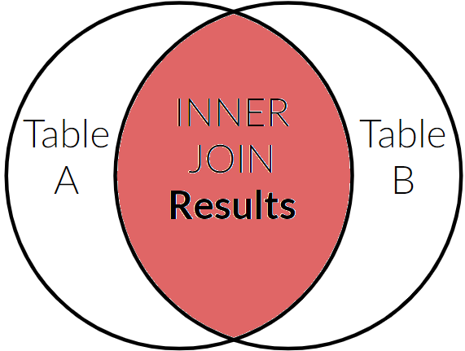
JOIN - OUTER JOIN
Not everything can be handled by an INNER JOIN. Some data is lost when the keys do not match.
Remember when we EXCLUDED Regions without Countries and Countries without Regions?
In these slides we will see how to solve for these problems.
Regions
Countries

Slide 5
JOIN - OUTER JOIN
To get the rows that do not match in an INNER JOIN, we need an OUTER JOIN.
There are 3 types of OUTER JOINS:
LEFT
RIGHT
FULL

Slide 6
JOIN - LEFT OUTER JOIN
The LEFT OUTER JOIN will return everything the INNER JOIN returned, in addition to any results that would have been missed on the LEFT table.
TableA (left) is Regions
TableB (right) is Countries
LEFT OUTER JOIN results:
All Regions
Countries with Regions
Excluded from results:
Countries not assigned to a Region!
TableA
LEFT OUTER
TableB
RIGHT OUTER
INNER JOIN

Slide 7
JOIN - LEFT OUTER JOIN
TableA
LEFT OUTER
TableB
RIGHT OUTER
The following SQL will return:
Regions without Countries
Regions with Countries
Countries with Regions
IMPORTANT QUESTION: What makes the Regions Table the LEFT table? ANSWER: It was called first. That’s it. :)
SELECT r.region_id, r.region_name,
c.country_id, c.country_name, c.region_id
FROM regions r
LEFT OUTER JOIN countries c
ON r.region_id = c.region_id;

Slide 8
JOIN - LEFT OUTER JOIN
Assuming the tables contain the following data, this would be the result of a LEFT OUTER JOIN:
region_id region_name
---------- ---------------------
1 Europe
2 Americas
5 Middle Earth
id country_name region_id
-- ------------ ---------
BE Belgium 1
CH Switzerland 1
AR Argentina 2
AT Atlantis NULL
REGION_ID REGION_NAME COUNTRY_ID COUNTRY_NAME REGION_ID
--------- ------------ ---------- -------------- ---------
1 Europe BE Belgium 1
1 Europe CH Switzerland 1
2 Americas AR Argentina 2
5 Middle Earth NULL NULL NULL
Note: LEFT OUTER JOIN results:
All Regions
Countries with Regions
Note2: Excluded from results: Countries not assigned to a Region

Slide 9
JOIN - RIGHT OUTER JOIN
The RIGHT OUTER JOIN will return everything the INNER JOIN returned, in addition to any results that would have been missed on the RIGHT table.
TableA (left) is Regions
TableB (right) is Countries
RIGHT OUTER JOIN results:
All Countries
Regions with Countries
Excluded from results:
Regions with no countries!
TableA
LEFT OUTER
TableB
RIGHT OUTER
INNER JOIN

Slide 10
JOIN - RIGHT OUTER JOIN
TableA
LEFT OUTER
TableB
RIGHT OUTER
INNER JOIN
The following SQL will return:
Countries who do not have a region
Countries with Regions
Regions with Countries
SELECT r.region_id, r.region_name,
c.country_id, c.country_name, c.region_id
FROM regions r
RIGHT OUTER JOIN countries c
ON r.region_id = c.region_id;

Slide 11
JOIN - RIGHT OUTER JOIN
Assuming the tables contain the following data, this would be the result of a RIGHT OUTER JOIN:
region_id region_name
---------- ---------------------
1 Europe
2 Americas
5 Middle Earth
id country_name region_id
-- ------------ ---------
BE Belgium 1
CH Switzerland 1
AR Argentina 2
AT Atlantis NULL
REGION_ID REGION_NAME COUNTRY_ID COUNTRY_NAME REGION_ID
--------- ------------ ---------- -------------- ---------
1 Europe BE Belgium 1
1 Europe CH Switzerland 1
2 Americas AR Argentina 2
NULL NULL AT Atlantis NULL
NOTE: RIGHT OUTER JOIN results:
All Countries
Regions with Countries
NOTE2: Excluded from results:
Regions with no countries

Slide 12
JOIN - FULL OUTER JOIN
The FULL OUTER JOIN will return everything the INNER JOIN returned, in addition to any results that would have been missed on both RIGHT and LEFT tables.
TableA (left) is Regions
TableB (right) is Countries
FULL OUTER JOIN results:
All Countries
All Regions
Excluded from results:
Nothing!
FULL OUTER JOIN
TableA
LEFT OUTER
TableB
RIGHT OUTER
INNER JOIN

Slide 13
JOIN - FULL OUTER JOIN
FULL OUTER JOIN
TableA
LEFT OUTER
TableB
RIGHT OUTER
INNER JOIN
The following SQL will return:
Countries who do not have a region
Countries with Regions
Regions with Countries
Regions without a Country
SELECT r.region_id, r.region_name,
c.country_id, c.country_name, c.region_id
FROM regions r
FULL OUTER JOIN countries c
ON r.region_id = c.region_id;

Slide 14
JOIN - FULL OUTER JOIN
Assuming the tables contain the following data, this would be the result of a FULL OUTER JOIN:
region_id region_name
---------- ---------------------
1 Europe
2 Americas
5 Middle Earth
id country_name region_id
-- ------------ ---------
AR Argentina 2
BE Belgium 1
CH Switzerland 1
AT Atlantis NULL
REGION_ID REGION_NAME COUNTRY_ID COUNTRY_NAME REGION_ID
--------- ------------ ---------- -------------- ---------
1 Europe BE Belgium 1
1 Europe CH Switzerland 1
2 Americas AR Argentina 2
5 Middle Earth NULL NULL NULL
NULL NULL AT Atlantis NULL

Slide 15
JOIN - Outer Area Results Only
Let’s say we only want the results in the LEFT OUTER portion and not the INNER JOIN results?
TableA (left) is Regions
TableB (right) is Countries
LEFT OUTER only results:
Regions without Countries
Excluded from results:
Countries without a region
Regions with Countries
TableA
LEFT OUTER
TableB
RIGHT OUTER
INNER JOIN

Slide 16
JOIN - LEFT OUTER JOIN
Recall that the RESULT of a LEFT OUTER JOIN would be:
What data on this result would help us filter out the rows with Countries?
In other words, we only want “Middle Earth” to be in our final result set.
REGION_ID REGION_NAME COUNTRY_ID COUNTRY_NAME REGION_ID
--------- ------------ ---------- -------------- ---------
1 Europe BE Belgium 1
1 Europe CH Switzerland 1
2 Americas AR Argentina 2
5 Middle Earth NULL NULL NULL

Slide 17
JOIN - LEFT OUTER JOIN
Regions
LEFT OUTER
Countries
RIGHT OUTER
INNER JOIN
The following SQL will return:
Regions without Countries
SELECT r.region_id, r.region_name,
c.country_id, c.country_name, c.region_id
FROM Regions r
LEFT OUTER JOIN countries c
ON r.region_id = c.region_id
WHERE c.region_id IS NULL;
REGION_ID REGION_NAME COUNTRY_ID COUNTRY_NAME REGION_ID
--------- ------------ ---------- -------------- ---------
5 Middle Earth NULL NULL NULL
NOTE: We can use any column that is defined as NOT NULL in Countries to check for NULLs
Notes:
It did NOT matter which column we choose on the Countries table.. they are all NULL

Slide 18
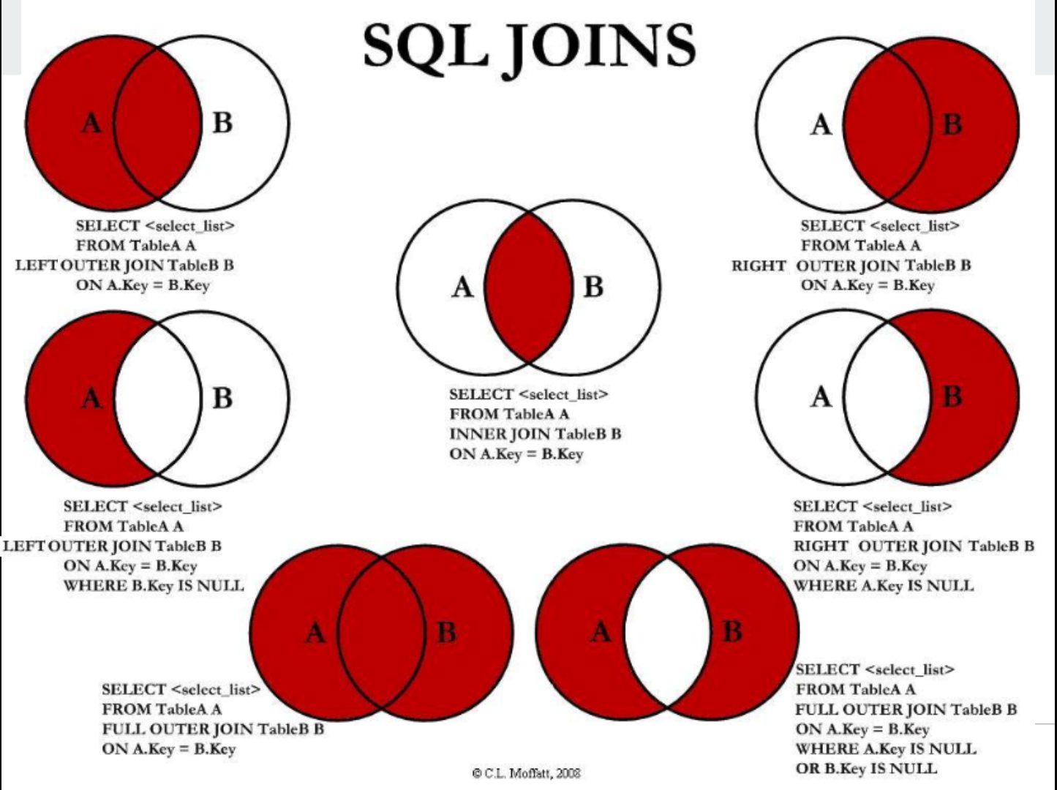
Notes:
It did NOT matter which column we choose on the Countries table.. they are all NULL

Slide 19
JOIN - Review
JOINs are useful to bring together rows from multiple tables into a single result set.
PRIMARY KEYS from one table may be referenced by FOREIGN KEYS in other tables.
Each row of a table will be compared with every row in another table, whether it is added to the result set or not.
In terms of computer processor running time, this makes JOINs very expensive!

Slide 20
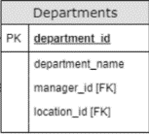
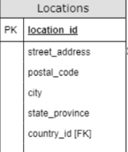

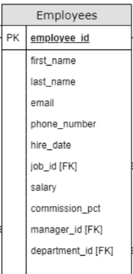
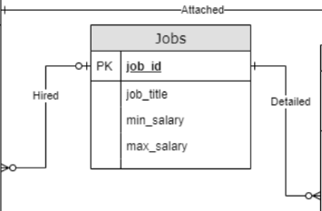
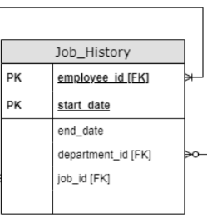
OUTER JOIN Practice
TRY IT!
Show the street address and city of all locations that do not have a department.
TRY IT … #2!
Show the full name and job title of all employees who do not have any job history. NOTE: Only employees who have switched jobs will have a job history!

Slide 21
OUTER JOIN - Practice
TRY IT! - SOLUTION: Show the street address and city of all locations that do not have a department.
SELECT l.street_address, l.city, d.location_id
FROM locations l
LEFT OUTER JOIN departments d
ON l.location_id = d.location_id
WHERE d.location_id IS NULL;

Slide 22
OUTER JOIN - Practice
TRY IT … #2! - SOLUTION: Show the full name and job title of all employees who do not have any job history. NOTE: Only employees who have switched jobs will have a job history!
SELECT e.first_name, e.last_name, j.job_title
FROM employees e
JOIN jobs j ON j.job_id = e.job_id
LEFT OUTER JOIN job_history h
ON e.employee_id = h.employee_id
WHERE h.employee_id IS NULL;

Slide 23
Alternative JOIN Syntax
We have shown how to join two tables using the JOIN ON syntax.
However, there are alternatives that you should be aware of and we will cover them here briefly.

Slide 24
Alternative JOIN Syntax - WHERE
The WHERE clause can be used to JOIN tables, notice that we use commas between the table names here:
This is an alternative to an INNER JOIN.
There are no alternatives to an OUTER JOIN.
SELECT e.first_name, e.last_name, j.job_title
FROM employees e, jobs j
WHERE j.job_id = e.job_id;

Slide 25
Alternative JOIN Syntax - WHERE
IMPORTANT NOTE:
The WHERE join syntax is very popular!
It was originally the ONLY way to JOIN tables, so you will find it being used all over the internet when you search.
You should familiarize yourself with it.
Other instructors may even prefer it as their default syntax.

Slide 26
Alternative JOIN Syntax - WHERE
When you join 3 or more tables using WHERE:
Comma separate each table.
Use the AND keyword in the WHERE clause.
Put the conditions in the order you would have if you were using the INNER JOIN ON syntax.
SELECT e.employee_id, j.job_title, d.department_name
FROM employees e, jobs j, departments d
WHERE j.job_id = e.job_id
AND d.department_id = e.department_id;

Slide 27
Alternative JOIN Syntax - NATURAL JOIN
NATURAL JOIN will take ALL columns with the same name in two tables and attempt to join based on their values:
This example ONLY works because job_id is the only column with the same name in both tables!
We managed to remove a lot of code, this may seem appealing… however...
SELECT e.first_name, e.last_name, j.job_title
FROM employees e NATURAL JOIN jobs j;

Slide 28
Alternative JOIN Syntax - NATURAL JOIN
NATURAL JOIN is NOT recommended
We only want you to be aware of its usage! They are not to be used in this course.
Imagine trying to NATURAL JOIN two tables that have the same NON-KEY column names. It would attempt to JOIN on ALL of them!
How often do you think these column names are used?
name, modified_on, description, id
Can you come up with more commonly used names?

Slide 29
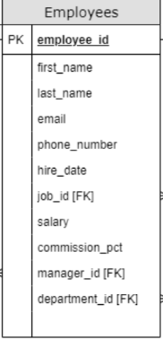
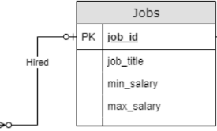
Alternative JOIN Syntax - JOIN USING
The JOIN USING syntax will attempt to join on a specified column name (must be the SAME NAME in both tables:
This example works because job_id is the same name in BOTH tables!
This would not have worked if the JOIN ON condition was something like: manager_id = employee_id.
SELECT e.first_name, e.last_name, j.job_title
FROM employees e
JOIN jobs j USING (job_id);

Slide 30
Alternative JOIN Syntax - CROSS JOIN
The CROSS JOIN will take EVERY row in one table and join it to every row in the 2nd table:
If there were 1000 rows in Employees and 200 rows in Jobs.
This would result in 1000 * 200 = 200,000 rows!
Note: this will also happen if you use the WHERE syntax to join a Primary key and Foreign key and forget to use a condition in your WHERE clause!
Is also referred to a CARTESIAN JOIN
SELECT e.first_name, e.last_name, j.job_title
FROM employees e CROSS JOIN jobs j;

Slide 31
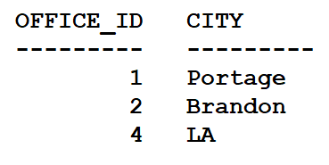
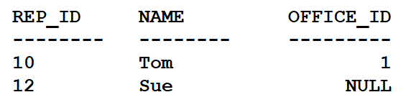
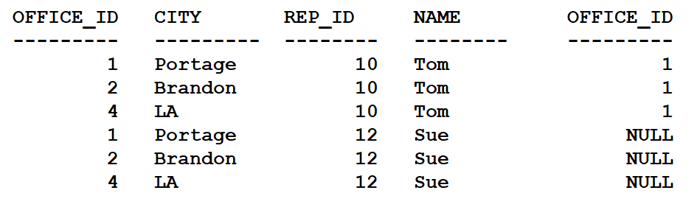
Alternative JOIN Syntax - CROSS JOIN Example
Why would you want this?
Answer: Data Mining. (not in the scope of our course!)

Slide 32
Equality JOIN
In all of our examples we have assumed that we want to join based on the Primary Key being equal in value to the Foreign Key.
This is sometimes called an Equi-JOIN (or Equality Join).
This is the most common type of join and we will be using this kind of join throughout the course.

Slide 33
Summary
We covered:
A review of Tables relationships:
Keys and ERD basics
JOIN ON Syntax:
Table prefixes (qualifying) and Aliases
Joining multiple tables
INNER vs OUTER JOIN
Alternative JOIN Syntax:
WHERE, NATURAL, USING, CROSSJOIN

Slide 34
Up Next . . .
We will be learning about SET Operators:
UNION ALL
UNION
INTERSECT

